Slide 1

Standards and Regulations
Team H : DockDockGo Sergi Widjaja, Siddhant Wadhwa, Sushanth Jayanth, Soham Bhave, Vineet Tambe
Notes:
Good Evening everyone, we’re excited to be back here sharing our project’s latest status with you after a summery little break.

Slide 2


Standards Chosen
ANSI RIA R15.08:2020
American National Standard for Industrial Mobile Robots - Safety Requirements
ANSI RIA R15.06:2012
American National Standard for Industrial Robots and Robot Systems - Safety Requirements

Slide 3
ANSI RIA R15.08:2020
Industrial Mobile Robots

Slide 4
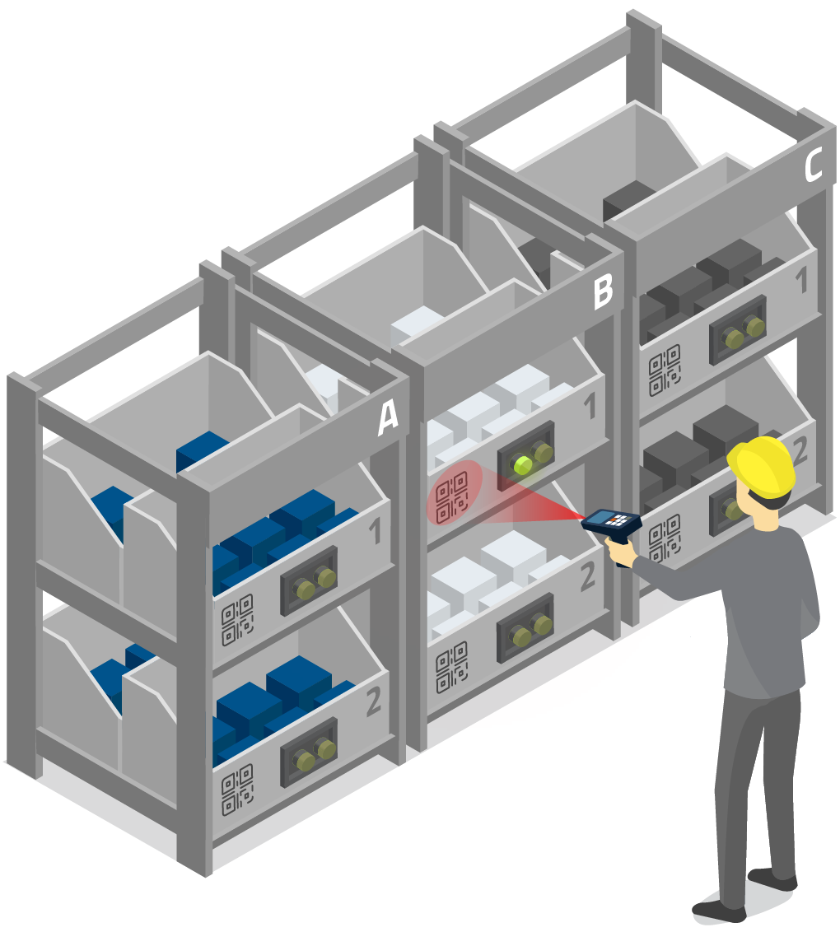
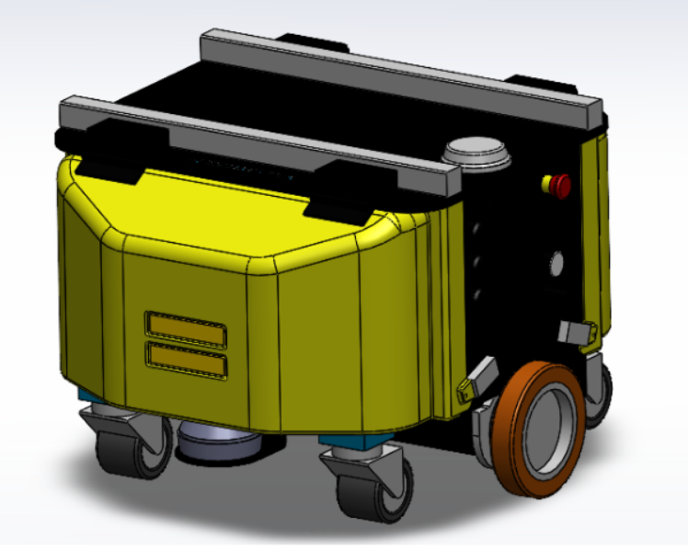
Overview
Safety requirements for Industrial Mobile Robots (IMRs)
Describes the basic hazards associated with IMRs in industrial requirements.
Provides requirements to eliminate or adequately reduce the described risks
For structured and semi-structured environments with trained personnel

Slide 5
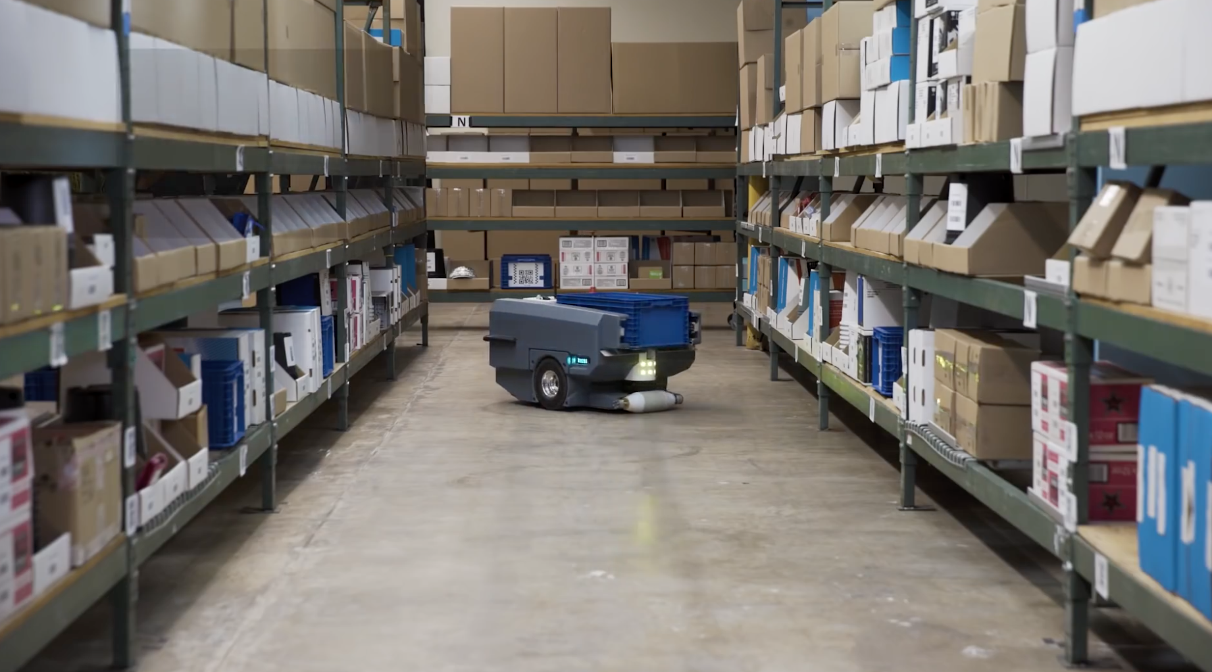
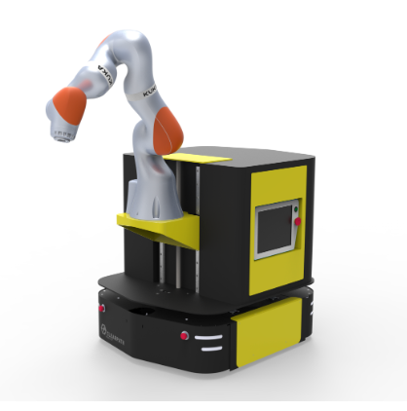
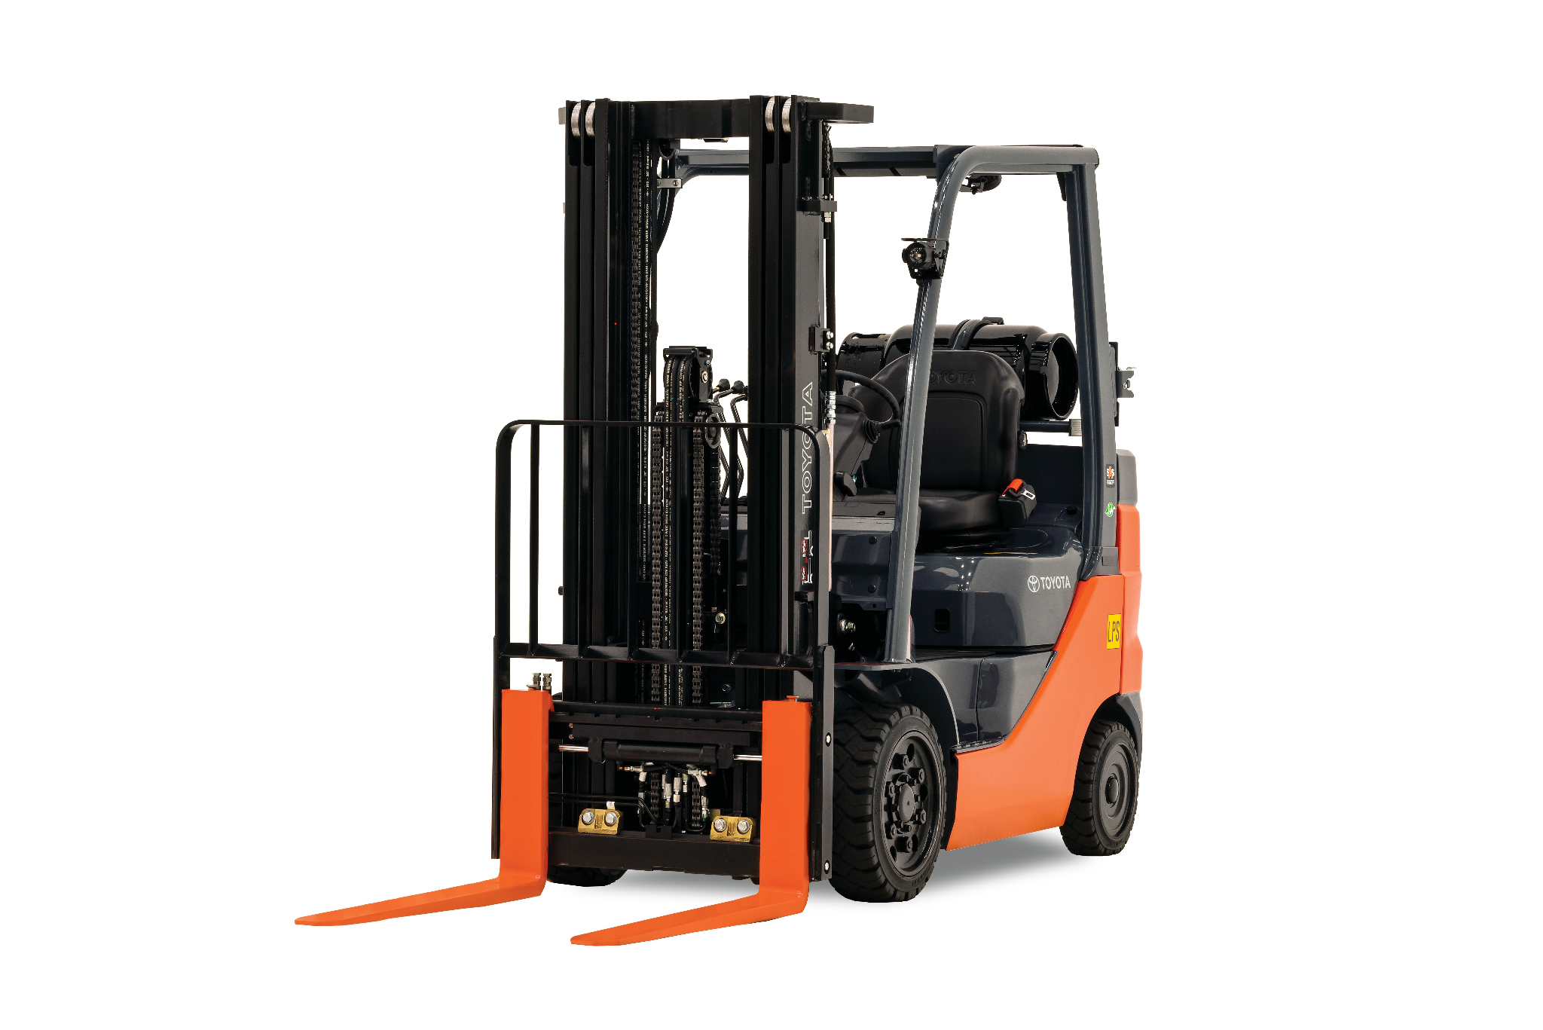


Applicable Products and Market
Covers applications that are strictly industrial
Manufacturing
Laboratory
Logistics
Etc.
Covers autonomous and a subset of guided mobile robots
Manually driven robots and/or instruments are explicitly excluded

Slide 6
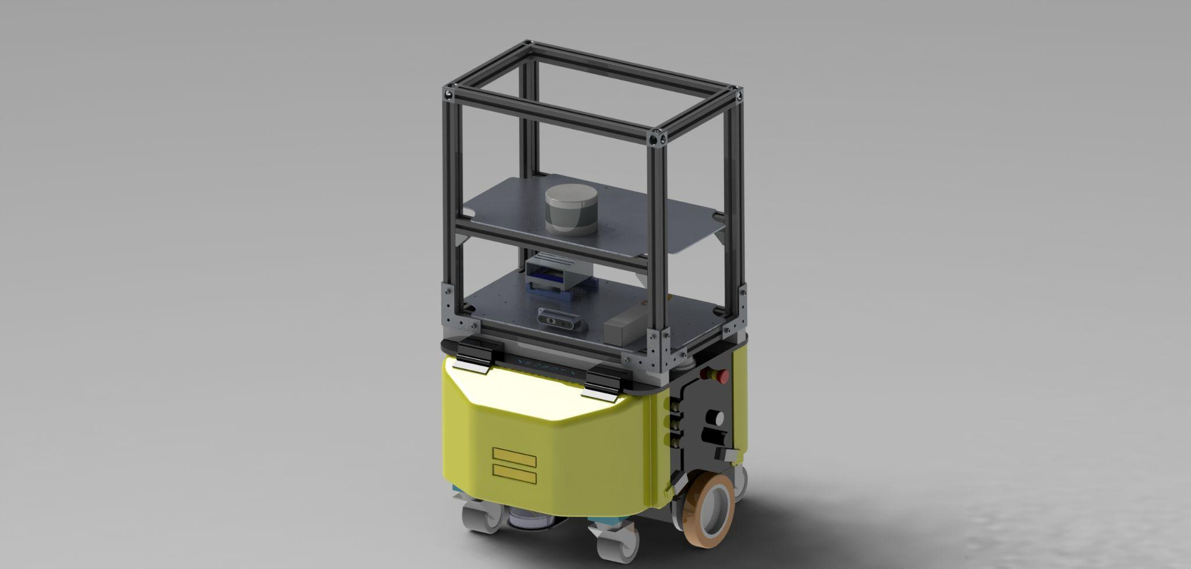
Different Types of IMRs
IMR Type A
No attachment
IMR Type C
Active Attachment
IMR Type B
Passive Attachment

Slide 7
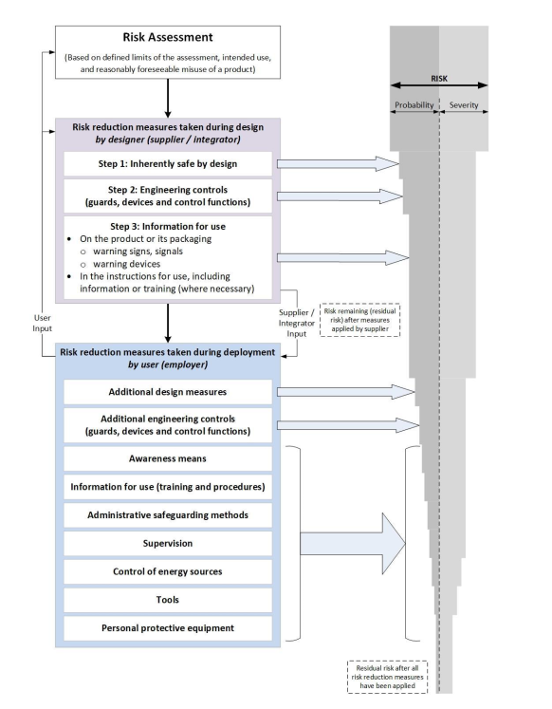
Main Prescription
Hazard analysis and risk assessment must be conducted conforming to the list of hazards outlined
Requirements must be derived from the standards
Risk assessment scope must encompass reasonably foreseeable misuse of a product
Decomposes risk reduction measures from supplier and user

Slide 8

Main Prescriptions
Modes of operation (automatic, semi-automatic, & manual)
Mobile platform are not permitted to operate in automatic mode if attachment is in manual mode, vice versa
Modes should be explicitly indicated
Control functions (e-stop, protective stop, etc)
Shall not impose sudden movements on the robot that might cause additional hazard
Automatic restart is permitted when obstacles are no longer visible
Navigation and control
Replanning should happen continually without hazards (dynamic obstacles, etc.)
Collision avoidance function should include the base platform and the attachment
Mobile manipulator velocity limiting must take into account the base platforms’ characteristics
Loss of localization must be handled gracefully

Slide 9
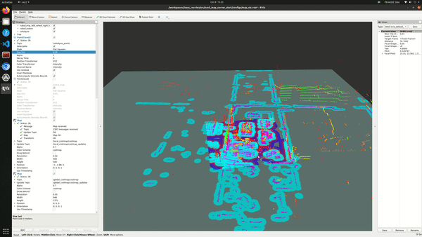
Application to Our Project
Project Attributes | Requirements derived by the standards
Neobotix control modes | Control mode must be explicitly indicated
 | Automatic restart when obstacles are no longer on the path of the AMR
 | Switching modes must not impose sudden movements
Navigation functions | Replanning happens continuously without hazard
 | Collision model must be derived from the mobile platform and the attachment
 | Loss of localization must be handled gracefully

Slide 10
ANSI RIA R15.06:2012
Industrial Mobile Robots

Slide 11




Main Prescription
Risk assessment and Hazard Identification
Design Requirements
Verification and Validation
Information for Use

Slide 12
Main Prescription
Perform risk assessment to enable systematic analysis and evaluation of the risks associated with the robot system over its whole life cycle.
Risk assessment should include -
Determination of limits of the system (Use limits, time limits, space limits, etc.)
Hazard Identification (Mechanical, Electrical, Themal, etc.)
Risk estimation & Evaluation

Slide 13

Main Prescription
Identified risks shall be eliminated or reduced first by design or by substitution, then by safeguarding and other complementary measures
Design Requirements:
General Requirements
Actuating Controls Requirements
Safety-related Control Requirements
Robot Stopping Functions
Speed Control
Operation Modes
Multi-robot Requirements
Collaborative Requirements

Slide 14
Main Prescription
Verification and Validation
Visual Inspection
Practical Tests
Observation during operation
Reviews of design, risk assessment
Information of Use
Information and instructions necessary for the correct use of the system
Information and warnings to the user about any residual risks.
Information for use from component machine manufacturers

Slide 15
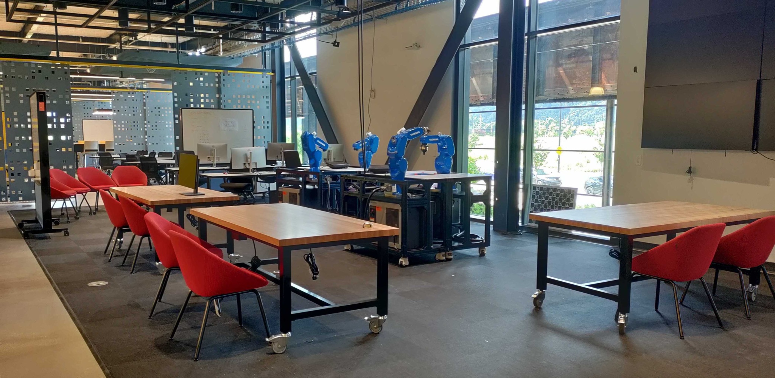
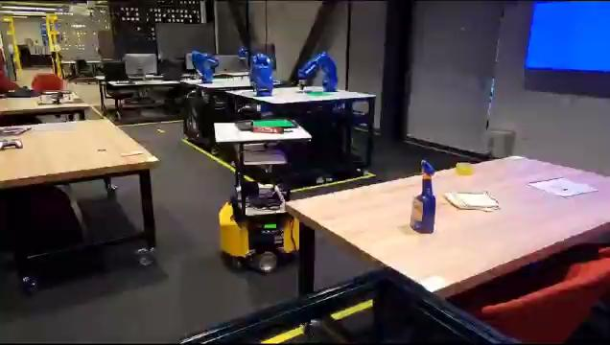
Application to Our Project
Project Attributes | Requirements derived by the standards
Embedded compute on the robot | Live electrical elements must be covered to avoid safety hazards
Navigate around the mezzanine area | Define safety zones where the robots operate and ensure measures are in place to prevent them from leaving these areas.
Means of e-stop initiation | User must have quick and unobstructed access to the e-stop means
Multi-robot planning and control | All robots must normally be in the same state during simultaneous operation.
 | Robot must be selected before it can be moved
Human-robot interaction (HRI) interface | Robots designed for collaboration shall provide visual indication when the robot is in collaborative mode

